Slide 1
PerfTest: Profiling Applications via ARM and TPTP
Yoonki Song
Last Updated: Sep. 11, 2009

Slide 2
Profiling
Prerequisites

Slide 3
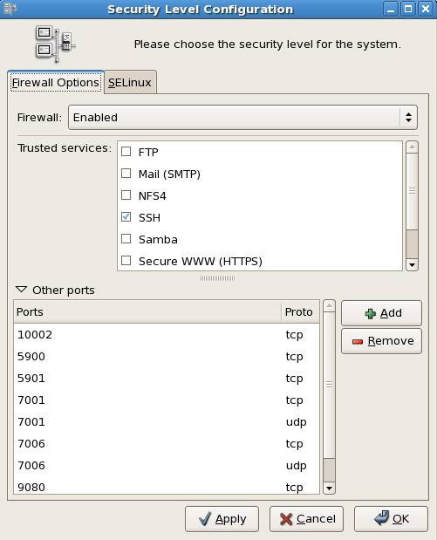
Ports
10002
10003
10004
10005
10006
5900
5901
9080
9090
system-config-securitylevel

Slide 4
IBM Rational Agent Controller (ACWinService.exe)

Slide 5
Instrumentation
# /root/perftest/gotoARM.sh
Start WebSphere Application Server (WSAS)
Note: WSAS should be running before applications are instrumented.
Start Instrumentation
Restart the server
Note: This task should be done only once.

Slide 6

Sequence for Collecting Trace data with Instrumentation (RPT-ARM)
Client
Server
#/root/perftest/startARM.sh
Start Rational Agent Controller (RAC)
Note: RAC should be running prior to DCI
Start Data Collection Infrastructure (DCI)
Note: DCI should be running prior to WSAS
Start WebSphere Application Server (WSAS)
4. Start DCI
5. Start RPTv8.0
6. Start Recording and Launching Test/Schedule via RPT
Trace data (A)
Note: This task should be done whenever the server/client reboots.
Notes:
3451 <- x
4513 <-

Slide 7
Converting ARM-instrumented to TPTP Environment
Check if WSAS is running
If not, start WSAS
Un-instrumentation
Reboot the server

Slide 8

Sequence for Collecting Trace data with Instrumentation(TPTP)
Client
Server
/root/perftest/*.sh
Start TPTP Agent Controller (TPTP-AC)
Start Data Collection Infrastructure (DCI)
Start WebSphere Application Server (WSAS)
Use TPTP to collect trace data
5. Our plug-in analyzes trace data (B)
Trace data (B)

Slide 9
Environment Variables on Windows
JAVA_PROFILER_HOME=%TPTP_AC_HOME%\plugins\org.eclipse.tptp.javaprofiler
TPTP_AC_HOME=C:\DevTools\eclipse\tptp.runtime.allInOne.win32.win32.x86-TPTP-4.5.1
PATH=%PATH%;%JAVA_PROFILER_HOME%;%TPTP_AC_HOME%\bin

Slide 10
.bashrc on Linux
# “PerftTest(ARM)” project
# “PerftTest(TPTP)” project
export TPTP_AC_HOME=/opt/TPTP
export JAVA_PROFILER_HOME=$TPTP_AC_HOME/plugins/org.eclipse.tptp.javaprofiler
export PATH=$TPTP_AC_HOME/bin:$JAVA_PROFILER_HOME
export LD_LIBRARY_HOME=$LD_LIBRARY_HOME:

Slide 11
File extensions
Extension | Description
executiondlr
Trcadlr
Trcaxmi | Trace Agent
Trciovxmi
Trcmxmi | Trace Monitor
Trcnxmi | Trace Node
Trcpxmi | Trace Process
trcxml

Slide 12
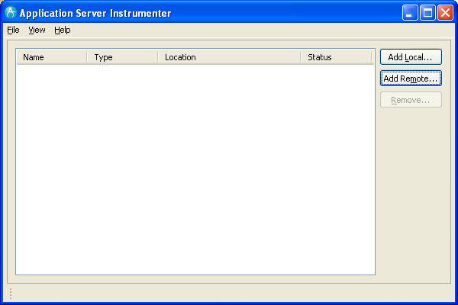
Application Server Instrumenter (ASI)

Slide 13
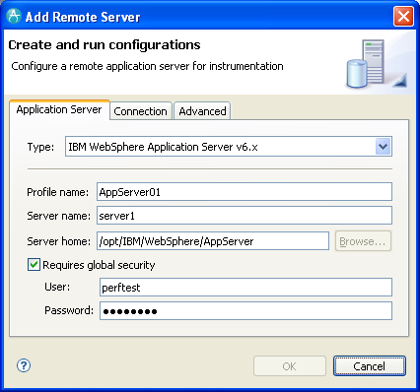
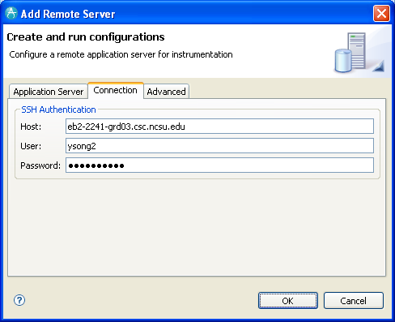
Application Server Instrumenter (ASI)

Slide 14
Application Server Instrumenter (ASI)
Application Server Tab
Type: IBM WebSphere Application Server v6.x
Profile name: AppSrv01
Server name: eb2-2241-grd03.csc.ncsu.edu
Server home: /opt/IBM/WebSphere/AppServer
User: perftest
Password: perftest
Connection Tab
Host: eb2-2241-grd03.csc.ncsu.edu or ldap.ncsu.edu (?)
User: ysong2
Password: <?>

Slide 15
…
{WAS_PROFILE_HOME}/config/cells/{cell_name}/nodes/{node_name}/servers/{server_name}
/opt/IBM/WebSphere/AppServer/profiles/AppSrv01/config/cells/eb2-2241-grd03Node01Cell/nodes/eb2-2241-grd03Node01/servers/server1/server.xml
/opt/IBM/WebSphere/AppServer/profiles/AppSrv01/config/cells/eb2-2241-grd03Node01Cell/nodes/eb2-2241-grd03Node01/servers/server1/variables.xml
{WAS_PROFILE_HOME}/config/cells/{cell_name}
/opt/IBM/WebSphere/AppServer/profiles/AppSrv01/config/cells/eb2-2241-grd03Node01Cell/pmirm.xml

Slide 16
…
/opt/IBM/SDP/DCI/rpa_prod/tivoli_comp/app/instrument/6.103.0000/appServers/server1_101/config

Slide 17
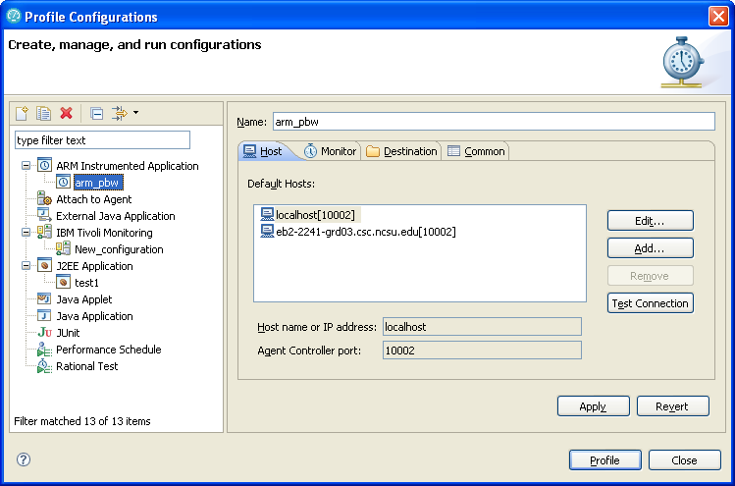
Profile Configurations

Slide 18
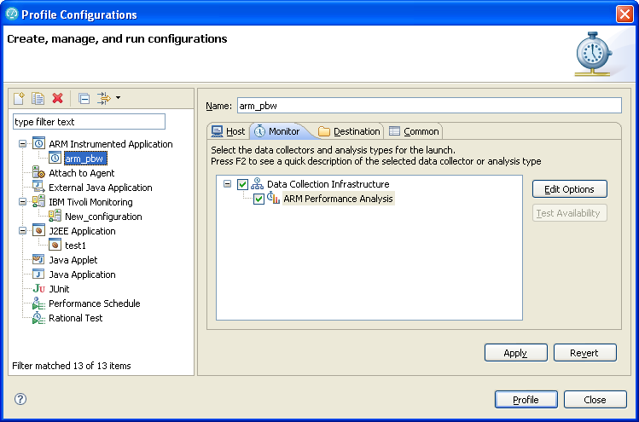
Profile Configurations (Cont’d)

Slide 19
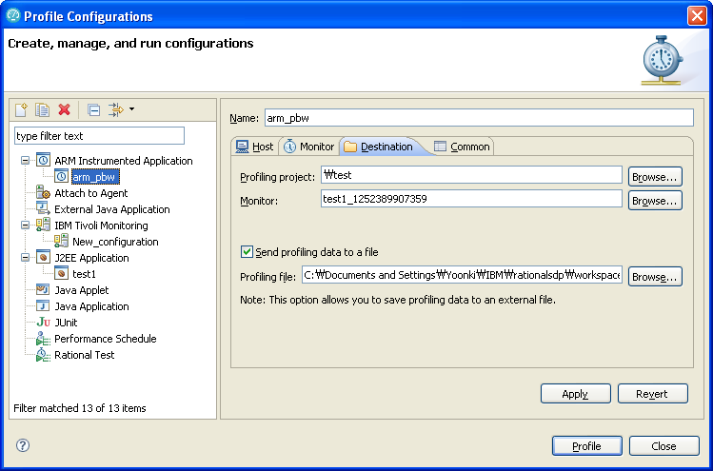
Profile Configurations (Cont’d)

Slide 20
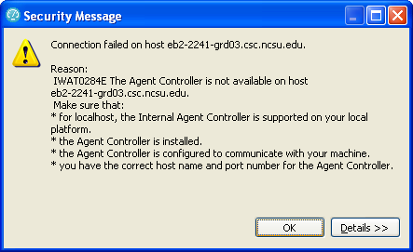
IWAT0284E

Slide 21
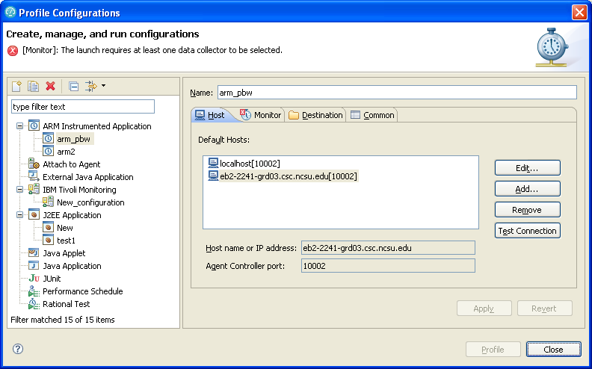

Slide 22
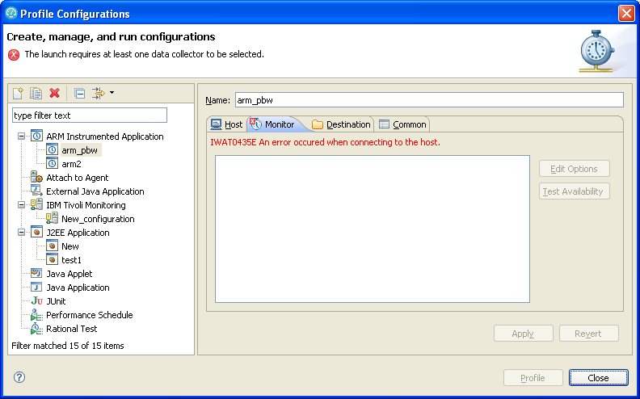
IWAT0435E

Slide 23
IWAT0284E

Slide 24
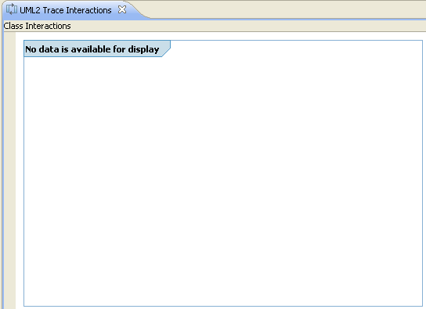
Trouble Shooting
No data available for display

Slide 25
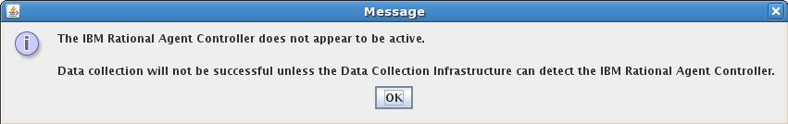
Trouble Shooting

Slide 26
Trouble Shooting

Slide 27
References
Install WebSphere Application Server V6.0 for Linux on POWER (http://www.ibm.com/developerworks/systems/library/es-webapp/index.html)
WebSphere Application Server 6.1 Headless Install (http://bishop.camp.clarkson.edu/wiki/en/WebSphere_Application_Server_6.1_Headless_Install)

Slide 28
References
Using IBM Rational Performance Tester: Application Monitoring Part 1, Configuring your environment (http://www.ibm.com/developerworks/rational/library/07/0515_patel/index.html)
Using IBM Rational Performance Tester: Application Monitoring Part 2, Enabling real-time monitoring (http://www.ibm.com/developerworks/rational/library/07/0515_patel2/index.html)
Using IBM Rational Performance Tester: Application monitoring, Part 3: Importing data from IBM Tivoli database products (http://www.ibm.com/developerworks/rational/library/07/0605_patel/index.html)

